Slide 1
Company & Products presentation
Visit Hub Brussels – RegTech - in Paris
18 Nov. 2025 v1.5s
Thibaut De Vylder, dFakto CEO
Notes:
Of course. Here is a rewritten version of the "Why bevault" page, focusing exclusively on business arguments as requested, and drawing information from the provided sources.
Why beVault? Turn Your Data Into Business Benefits, Faster.
In today's economy, the ability to rapidly transform data into actionable insights is a critical competitive advantage. However, many organizations struggle with complex data landscapes, slow project delivery, and the high cost of data management. Projects are delayed by a lack of reliable data, scarce technical resources, and tools that fail to bridge the gap between business needs and IT capabilities.
beVault was designed to solve these business challenges. It is an all-in-one, business-centric platform that empowers your organization to build future-proof data products five times faster, enabling you to increase revenue, reduce costs, and minimize risk.
Accelerate Time-to-Value and Drive Growth
Problem: Your key data initiatives are slow to deliver value. Manual processes, technical debt, and a dependency on scarce data engineers create bottlenecks, delaying insights and hindering your ability to respond to market changes.
Our Solution: beVault automates the entire data pipeline, from data integration to the delivery of analytics-ready data products. Our model-driven, low-code approach drastically reduces development time, allowing you to launch new business cases in weeks, not months.
Real-World Impact: One of our clients was able to shrink their forecasting exercise from two months to just three days, achieving 2% accuracy. This agility allowed them to reallocate resources and focus on strategic growth. Another client achieved a significant return on investment by improving data quality, which led to a €168k annual cost reduction from fewer undue fees and a €2 million revenue increase from more accurate billing.
Empower Business & IT Collaboration
Problem: A persistent gap between business and IT teams stifles innovation. Business users lack autonomy and struggle to get the data they need, while IT teams are overwhelmed with complex technical requests.
Our Solution: beVault provides a shared, business-oriented space for IT and business teams to co-construct data solutions. Our user-friendly interface is designed for "techno business consultants"—business users with modeling skills—not just data experts. This approach ensures that data products are aligned with business logic from the start, fostering a truly data-driven culture.
Build a Single Source of Truth: Unify data from dozens of disparate systems (CRM, ERP, etc.) into a consistent, reliable view that everyone can trust. This eliminates data silos and competing "shadow systems," ensuring decisions are based on one version of the truth.
Reduce Costs and Minimize Risk
Problem: Traditional data management is expensive. Building custom solutions requires high upfront investment (CapEx) and significant ongoing operational costs (OpEx) for maintenance and multiple software licenses. Poor data quality further inflates costs and exposes your organization to compliance and operational risks.
Our Solution: beVault is an all-in-one platform that consolidates model management, data quality, and orchestration into a single, cost-effective solution, reducing the need for multiple licenses and specialized experts.
Embedded Data Quality & Governance: Build trust in your data with an integrated framework to measure and improve data quality across all sources. This is critical, as high-quality data is the foundation for accurate reporting, reliable analytics, and successful AI initiatives.
Auditability and Compliance: beVault ensures full historization and traceability of your data, simplifying audits and helping you meet regulatory requirements like GDPR. Our solution is certified by the Data Vault Alliance, a guarantee of compliance with rigorous industry standards that is valued by large corporations and consultants.
Build a Future-Proof Foundation for Innovation
Problem: Your current data architecture is rigid and struggles to adapt to changing business needs, new data sources, or emerging technologies like AI.
Our Solution: beVault’s flexible, model-driven architecture is designed for evolution. You can start small with a single use case and easily extend the model over time without rebuilding everything from scratch. This creates a sustainable and scalable data asset that supports your long-term vision.
Become AI-Ready: AI is only as good as the data it's fed. beVault provides the high-quality, reliable, and historized data needed to fuel your AI and predictive models, ensuring your organization is ready to leverage game-changing technology for a competitive edge.
Technology Agnostic: Deploy beVault wherever it makes sense for your business—on-premises, in the cloud, or hybrid—and connect it to your preferred databases and BI tools, protecting you from vendor lock-in.

Slide 2

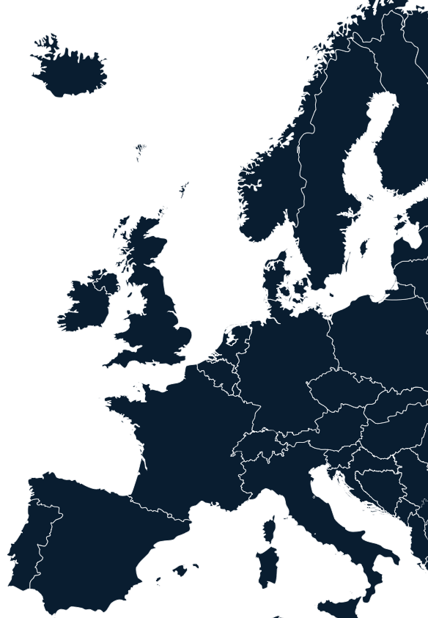
Who we are ?
dFakto is a software publisher and
asset-based consulting firm
based in Brussels, Paris & Chicago.
Our beVault and proPilot solutions enable organizations to achieve above than expected benefits in data management automation and simple piloting of complex portfolios
dFakto is also :
25 years' experience in data-driven management
International team of 50 experts in data-driven management
Public and private sector customers
Ecosystem of integrators & support partners
Infrastructure expertise in complex secure environnements
About dFakto

Slide 3

Product Presentation
Thibaut De Vylder – dFakto CEO
18st & 19th of Sept 2025, BCN tour with Hub.brussels
built to run • designed to change

Slide 4

Solving the data-management paradox
business data tools = fast results, but don’t scale.
data tech platforms = broad potential, but slow to deliver tangible value.
deliver outcomes now and in the future
at a fraction of the time and cost traditional approach would do

Slide 5
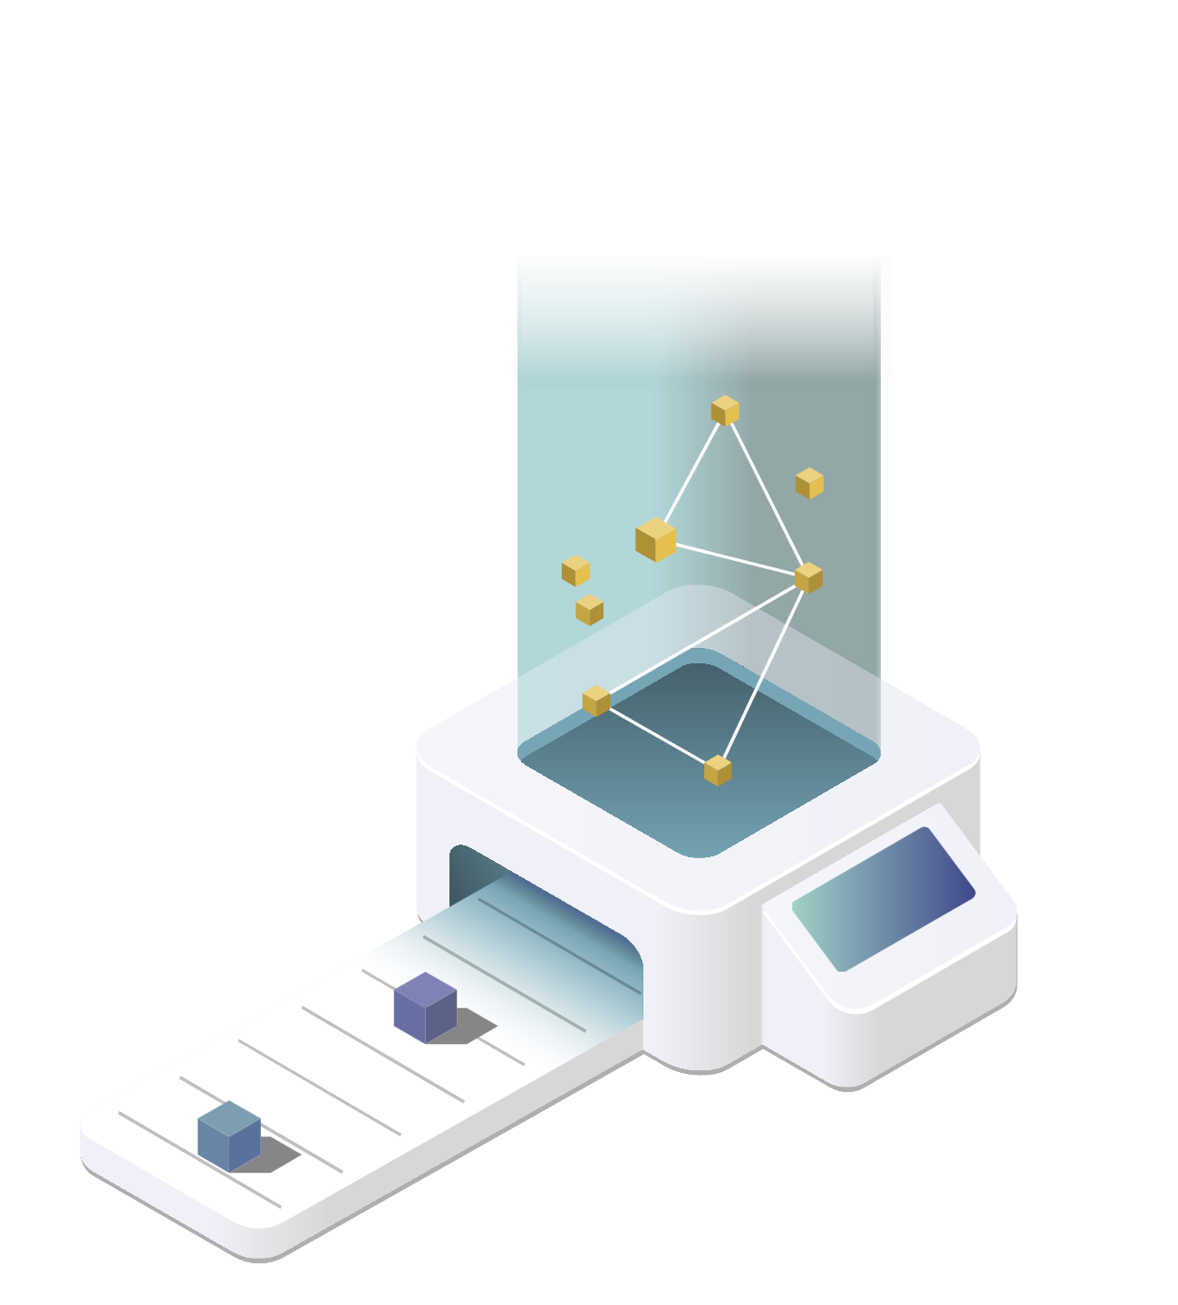



























Source 1
Artificial
Intelligence
Source 2
Business
Intelligence
…
Data
Governance
Source N
2000
2025
customer
Vault
assoc
Vault
facility
Vault
risk
Vault
retail
Vault
ai
Vault
cash
Vault
PPPMO
Vault
fin
Vault
gov
Vault
bet
Vault

Slide 6
















They trust us
0.1
Financial Serv.
Industry
Retail
Event / MICE
Public Sector
About dFakto
Associations & non-profit

Slide 7
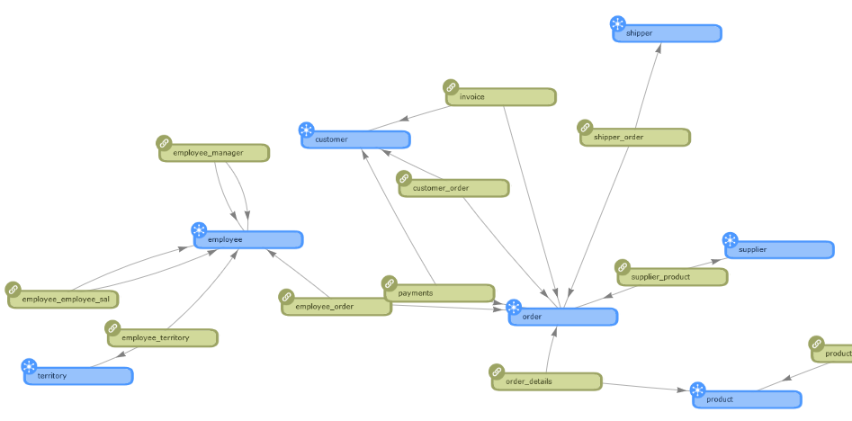
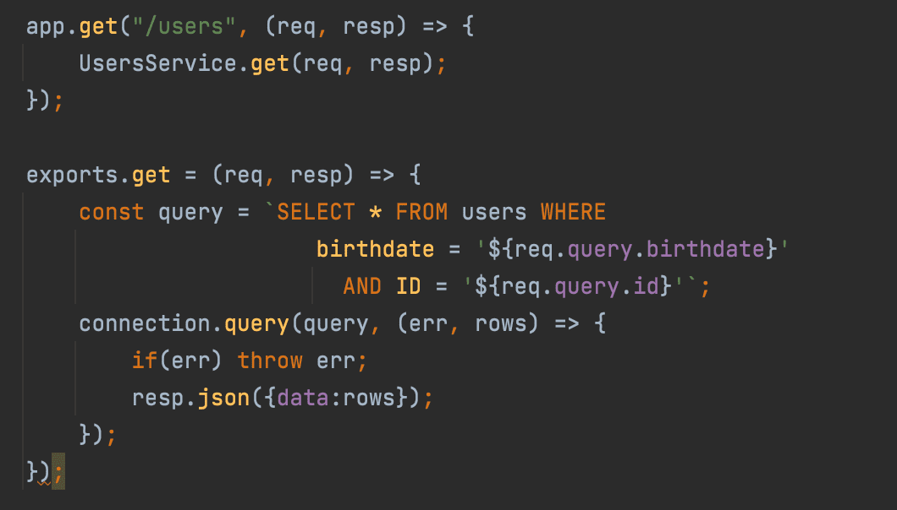
1.1
Paradigm shift 1 : Coding → Modelling
From coding a data mgmt. solution
To modelling a data mgmt. solution
Objectives
1 Business Analyst for 3-5 Developers
High maintenance effort
Each evolution must be tested from zero
1 Business Analyst for <1 Developer
Easy to run and maintain
Easy to evolve for new business needs

Slide 8
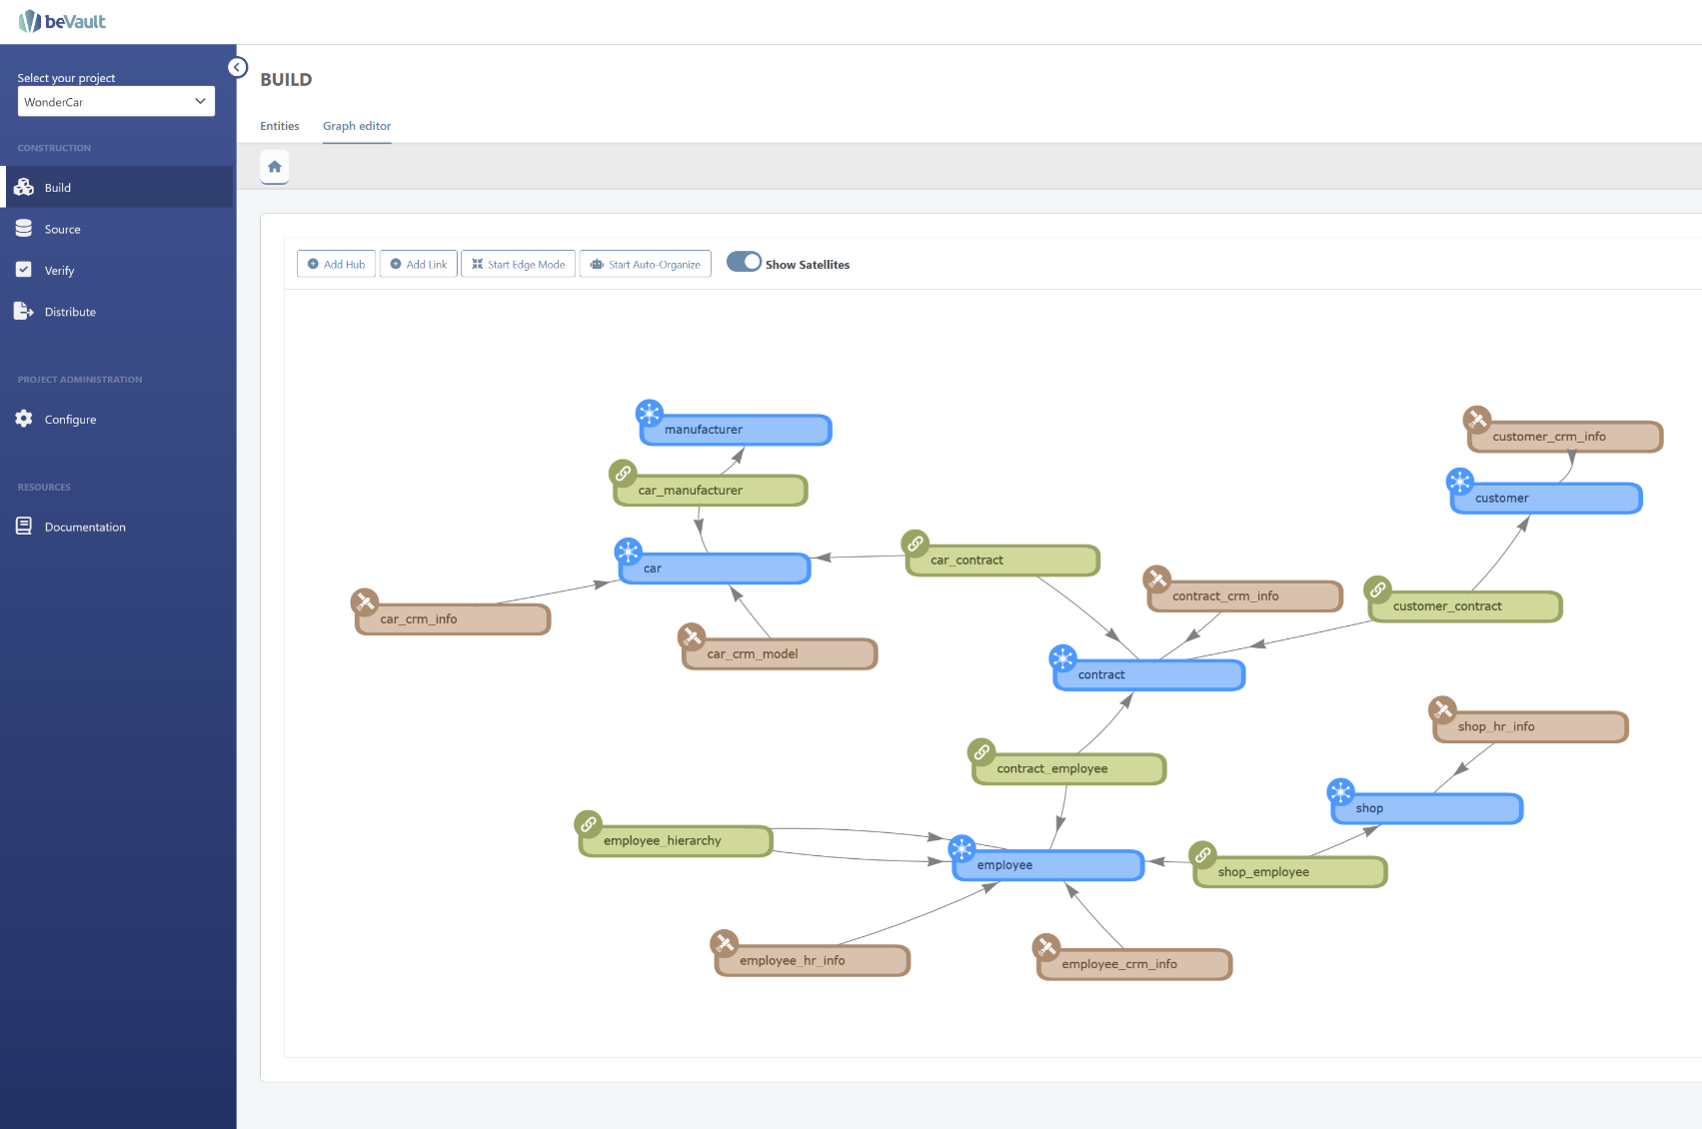
Paradigm shift 2 : Tech data → Business data
A barrier falls between business and technical interpretation.
A standardized methodology through a fully automated software.
A shared understanding through 3 concepts: hubs, links, satellites.

Slide 9
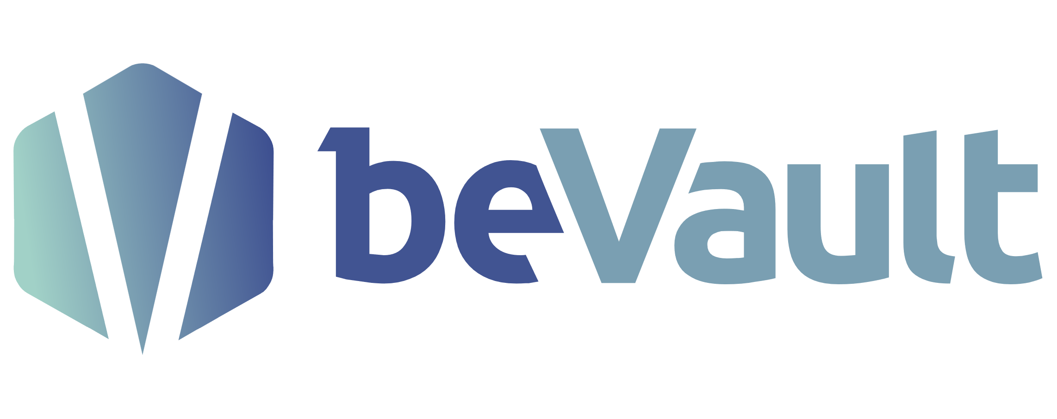
1.1
beVault’s purpose
transformation of data sources into data products
DATA SOURCE₁
DATA SOURCE₂
DATA PRODUCT₁
DATA SOURCE...
DATA PRODUCT…
DATA PRODUCT_{m}
DATA SOURCE_{n}

Slide 10
Which data sources?
Any data sources!
1. Structured Data Sources
Relational Databases (RDBMS):
MySQL, PostgreSQL, Oracle, SQL Server
Data Warehouses:
Snowflake, Amazon Redshift, Google BigQuery
Enterprise Resource Planning (ERP) Systems: SAP, Oracle ERP, Microsoft Dynamics, Odoo
Customer Relationship Management (CRM) Systems:
Salesforce, HubSpot, Microsoft Dynamics CRM
2. Semi-Structured Data Sources
JSON, XML, YAML Files:
API responses, configuration files
NoSQL Databases:
MongoDB, Cassandra, CouchDB
Data Lakes:
AWS S3, Azure Data Lake, Google Cloud Storage
3. Unstructured Data Sources
Documents & Text Files:
PDFs, Word documents, logs
Emails:
Outlook, Gmail archives
Multimedia Content:
Images, videos, audio files
Social Media Data:
Twitter, LinkedIn, Facebook, Instagram
4. Machine-Generated Data Sources
IoT Devices & Sensors:
Smart meters, wearables, industrial IoT sensors
System Logs & Telemetry:
Server logs, application logs
Geospatial Data:
GPS, GIS databases, Google Maps APIs
5. External Data Sources
Open Data Platforms:
Government portals (data.gov, Eurostat, World Bank)
Market & Industry Reports:
Gartner, Forrester, Statista
Web Scraping & APIs:
Financial data from Bloomberg, weather APIs, stock market feeds, Airports, Hotels…
6. Streaming & Real-Time Data Sources
Cloud Storage:
Google Drive, OneDrive, Dropbox
Collaboration Tools:
Slack, Microsoft Teams, Notion, Jira
SaaS Analytics Tools:
Google Analytics, Mixpanel, Adobe Analytics
8. Legacy & On-Premise Data Sources
Legacy Systems:
Mainframes, AS/400
On-Premise Data Lakes:
Hadoop clusters, private cloud storage
Private APIs & Internal Data Feeds:
Custom-built company APIs
Message Queues & Event Streaming: Apache Kafka, AWS Kinesis, Google Pub/Sub
Real-Time Monitoring Tools:
Prometheus, Grafana
CDNs & Edge Computing Data:
Cloudflare logs, AWS Lambda Edge
7. Cloud-Based & SaaS Data Sources

Slide 11
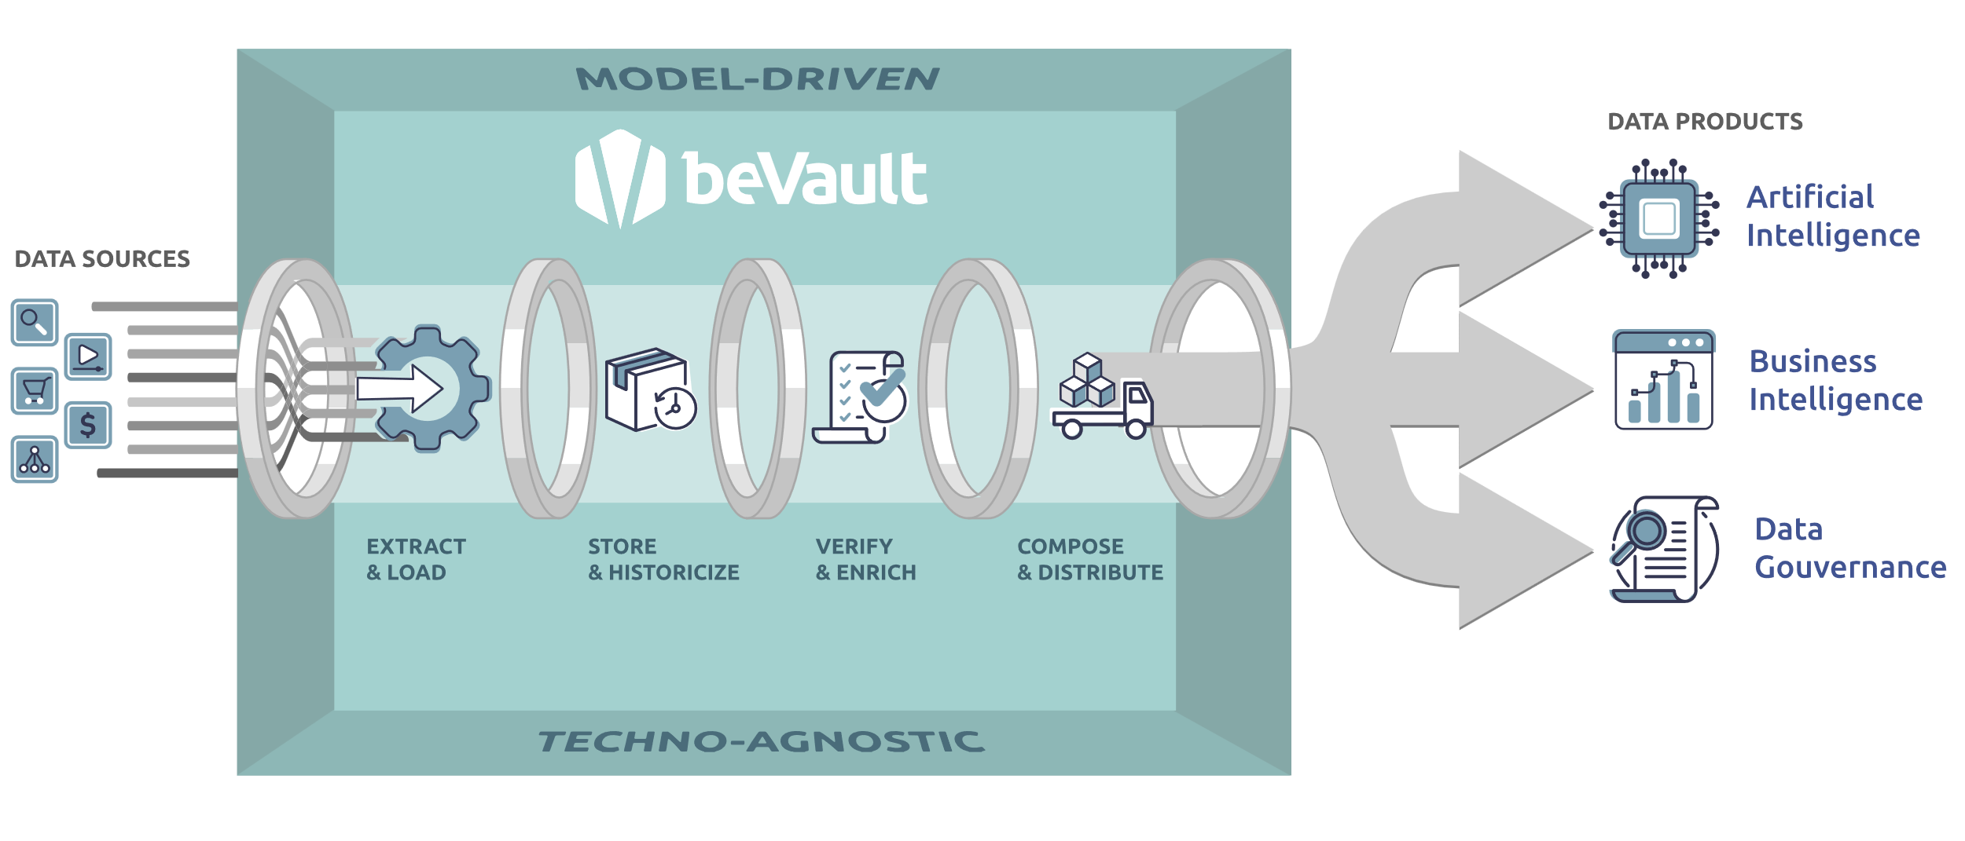
Which data products?
3 data products linked to 3 types of benefits
New
Revenue Streams
Increased Efficiency
More
Data trust & Compliance
allows
Gen AI & Agentic RAG AI feed, agents customisation…
enables
Reports & dashboards, API’s,
reporting template,
Self-service BI…
generates
data quality, compliance checks, feed of data stewards and governance meeting…

Slide 12
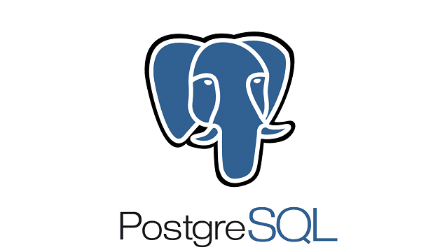
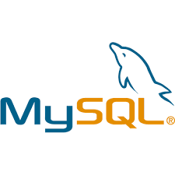







beVault Architecture :
5 simple modules, not more!
2.9
#2. SOURCE
#1. BUILD
#3. VERIFY
#4. DISTRIBUTE
How it works?
#5. ORCHESTRATOR

Slide 13
An automated data management platform lies in
its ability to run and change concurrently
✅ Change
Adapt dynamically to new business needs, regulations, and technology trends.
✅ Run
Maintain consistent, high-performance, and reliable data operations.
RUN
Changing Dynamically:
Adapting to Business and Technology Evolution
A. Rapid Adaptation to Business & Tech Changes
B. Low-Code & No-Code Flexibility
C. Model-Driven Automation for Scalability
D. Supporting Hybrid and Multi-Cloud Architectures
E. Future-Proofing Against AI and Regulatory Trends
CHANGE
Running Efficiently:
Ensuring Reliability and Performance
A. End-to-End Data Processing & Integration
B. High-Quality Data for Decision-Making
C. Cost and Resource Optimization
D. Compliance and Audit Readiness
By balancing these two capabilities, organisations ensure business continuity, data integrity, and innovation at scale—without the bottlenecks of traditional manual data management approaches.

Slide 14
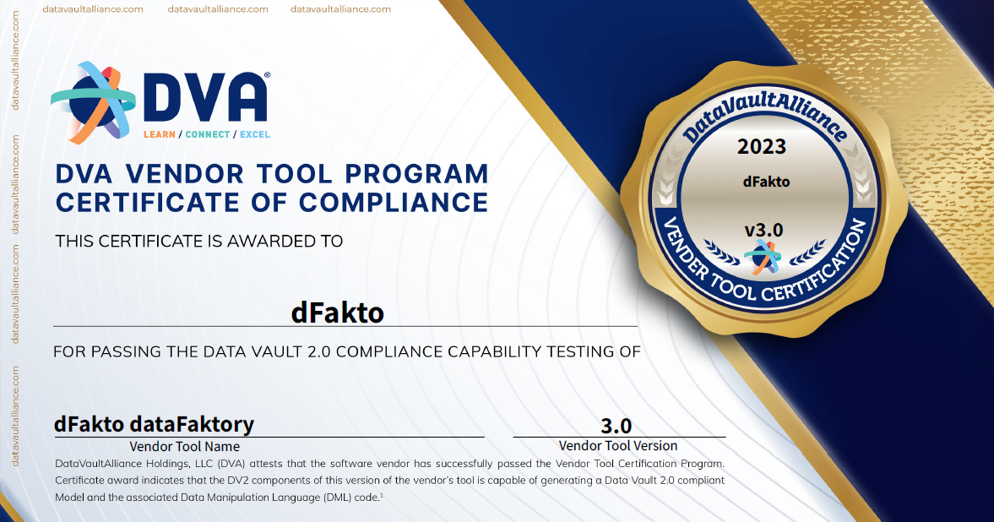
Paradigm shift 3 : Use semantic data modelling
4.1
DataVault 2.0 is an innovative modeling methodology that enables the integration of multiple data sources into a scalable semantic & ontologic data model.
The advantages of dataVault 2.0
Build your data warehouse incrementally by integrating data sources one by one, allowing you to start benefiting from your platform without waiting for a complete integration.
All data is stored at the lowest level of granularity, capturing the complete history of changes, ensuring that no information is lost and providing a detailed view of data evolution over time.
Changes can be made at all levels to evolve the model in DataVault 2.0. This includes entities, attributes, or relationships between entities.
Traceability of all data and data model changes to ensure complete auditability.
Guarantee of Quality

Slide 15


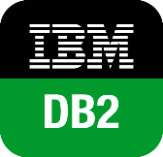
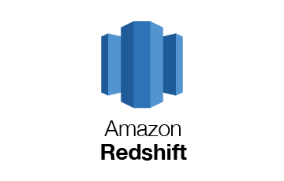
Choose your infra
Cloud / Hyperscalers
  AWS
  MS AZURE
  Google
  OVH cloud
Private Cloud / on-premise
dFakto’s hosting*
Hybrid infra’s (project based)
Choose your target DB
PostGREsql
MySQL
Snowflake
IBMDB2
Redshift**
Change anytime…
Paradigm shift 4 : Techno-Agnostic
1
2.9
Choose you infra/on-prem & data base
& change whenever you want!
RUN
CHANGE
*
2
How it works?
SET-UP
*
3
2
1
3
* Standard hosting & DB solution hosted by dFakto; ** available since 2025 Q2

Slide 16
Product Presentation
beVault Busines Cases

Slide 17

Business Case #1 : REG TECH
data governance & data quality on banking contracts
LOCAL
CENTRAL CHAINS
COLLECTOR
CHAIN 1
Quote
“Trust these guys"
Piet van Aken,
BNPParibasFortis Chief Risk Officer
CHAIN 2
DQ OPERATIONAL SYSTEMS
DQ
SOURCED DATA
CHAIN 3
DQ INDUSTRIAL BACK OFFICE
1
2
THERMOMETERS & KPI’s
PRODUCTION
CUBE
(AS IS)
3
DQ IMPROVEMENT & COMMUNICATION
PREDICTION TOOL
5
4
Key Metrics
26 millions contracts
140 different data quality controls applied on contracts
From 8 hours Main Frame computing
to 4 seconds in-memory computing time for stress test, sensitiivity analysis, terms and condition
SIMULATIONS
SIMULATION
CUBEs
(FUTURE)
STRESS TESTS
7
SENSITIVITY
6
6
Reporting layer
DQ INDUSTRIAL FRONT OFFICE
DQ PREVENTION, ANALYSIS & CONTROL
FORECASTING
8

Slide 18

Business Case #2 : Data Governance
Jan De Nul’s data migration & data quality platform (2/2)
dFakto's contribution:
Implementation of a maintainable framework for the management of key concepts (ships, projects, joint ventures, employees, allowances, financial flows) in all operating systems (CRM, ERP, financial and accounting systems, etc.).
Production of repositories for three pilot concepts in eight different AS-IS systems.
Implementation of data quality controls for three concepts in eight systems and in the TO-BE ERP system.
Providing data quality and system owner support : reports showing quality and MDM issues, as well as possible solutions.
The implementation made it possible to store MDM and data quality information in the same data management platform as the business data.
Customer benefits:
Simplify the data management process by storing MDM and data quality information in the same platform as business data.
Scalable and adaptable solution thanks to the data-vault model, facilitating the addition of new concepts and systems.
Improved data quality with controls and reports that provide actionable insights.
Rapid implementation with results within weeks, allowing Jan De Nul to focus on its core business.
Quote
“beVault can deliver first results in weeks, enabling organizations to realize quick wins and demonstrate its value"
Paul Lievens, Group CFO
Key Metrics
8 system sources feeding 18 business concepts (Hubs) corresponding to 1 million objects (vessels, HR, projects…)
400+ data quality controls on 330+ attributes
11,8 millions of daily quality checks

Slide 19

Business Case #3: Automated DMP
parking.brussels’ data management platform (2/2)
dFakto's contribution:
dFakto provides integration, data modeling, and makes consolidated data accessible to power systems and visualization.
dFakto's data team consists of "data engineer" profiles for technical implementation, "data business" for the creation of the model and the monitoring of integrations, and "visualization profile" for the creation of reports based on the mart information.
dFakto offers a training program and skills and autonomy development on the DWH in 3 phases: dFakto first has the lead, then a mixed phase and then Parking.Brussels takes over the lead with dFakto in support.
Customer benefits:
The Parkcheck project, a priority project, makes it possible to activate the ROI (Return on Investment).
The Parkcheck project allows for a reduction in claims, with a reduction in undue fees, representing a significant cost reduction.
The Parkcheck project allows for simplified fee invalidations through a single report, reducing the time required and the associated costs.
The improvement in data quality makes it possible to issue ‘readvances’ that were not previously sent, thus increasing revenues in a substantial way (€>2 million on a yearly basis)
Quote
‘We now have strong data foundations to move forward’
Denis Lievens, Adjoint au Directeur Général.
Key Metrics
+2,4% fine in volume (after correction) corresponding to revenue increase of +2M€ per year, recurring
Decrease of 3,8 FTE in complains processing & administration
Pay-back in 4 months

Slide 20

Business Case #4: Vertical AI Data Platform
destinAItor’s AI data platform for the Meetings Event Industry
dFakto's contribution:
dFakto is the provider of destinAItor technology and its infrastructure.
manages the technical development, including data collection, aggregation and processing.
provides the proPilot and beVault tools, used by destinAItor in the form of annual subscriptions.
develops and integrates the AI agents used by the platform.
will take care of the technological aspects such as data security.
contributes to the creation of reports and dashboards for destinations.
provides technical support and help desk for users.
Operations and maintenance of web platform on www.destinaitor.com
Quote
“This is going to revolutionize the way that site selection is done. I believe that event organizers are being tasked with bringing value to the role, yet we’re still stuck doing some pretty mundane tasks that are unfortunately still very important — but they’re very time-consuming. In 2025, on my watch, we will be rolling out destinAItor, which will completely transform how event organizers select destinations.”
Niel Brownlee, Chairman of the board PCMA 2025
Benefits for destinations:
Better control over their image and data in AI tools.
The ability to validate and update their information frequently.
An increased understanding of how event planners look for them.
Reports and dashboards to optimize their attractiveness.
Qualified lead generation and direct contact with interested users.
Reducing the time spent responding to requests for information through the AI platform.
The ability to use reporting tools.
The ability to work with a help desk and comprehensive documentation.
Better visibility for event venues.
Benefits for event professionals:
Access to reliable and up-to-date information
An efficient and personalized search tool to identify suitable destinations.
A better understanding of sustainability issues and environmental constraints.
Saves time in event research and planning.
The ability to use the platform through different channels, such as voice, WhatsApp, and Teams.
The ability to improve event proposals using the information generated by the platform.
The platform is designed to improve productivity.
&
Key Metrics
10k event professionals connected in Jan ‘25 (30k in Dec ’25)
500 destinations in March 25; and 1000 destinations planned by Dec 26
>200 data points per destination
Click here to try destinaitor.com live

Slide 21
Simplify Complexity.
Thibaut De Vylder, CEO dFakto
November 26, 2025

Slide 22








All major initiaves have a portfolio of activities to create value!
Transformation
Programs
Busines as Usual
Portfolio’s
Decision-makers
Cross-functional projects
Strategic
Programs
(re)Plan
Measure
Performance
Management
IT Projects

Slide 23






proPilot makes crucial information flows more reliable and faster
Decision Makers
One version of the plans
proPilot provides a central platform for all plans, ensuring clarity and alignment within the organization
One version of the gaps
One version of the truth
proPilot measures gaps in real-time, enabling proactive identification of issues and opportunities to solve them faster, sometime before they have a negative impact
The automated dashboards & reports produce frequently a single version of the truth to make informed decisions & decide faster
One version of the realisations
proPilot collects real-time progress and issues from stakeholders in the field in less than a minute per month
Execution Makers

Slide 24
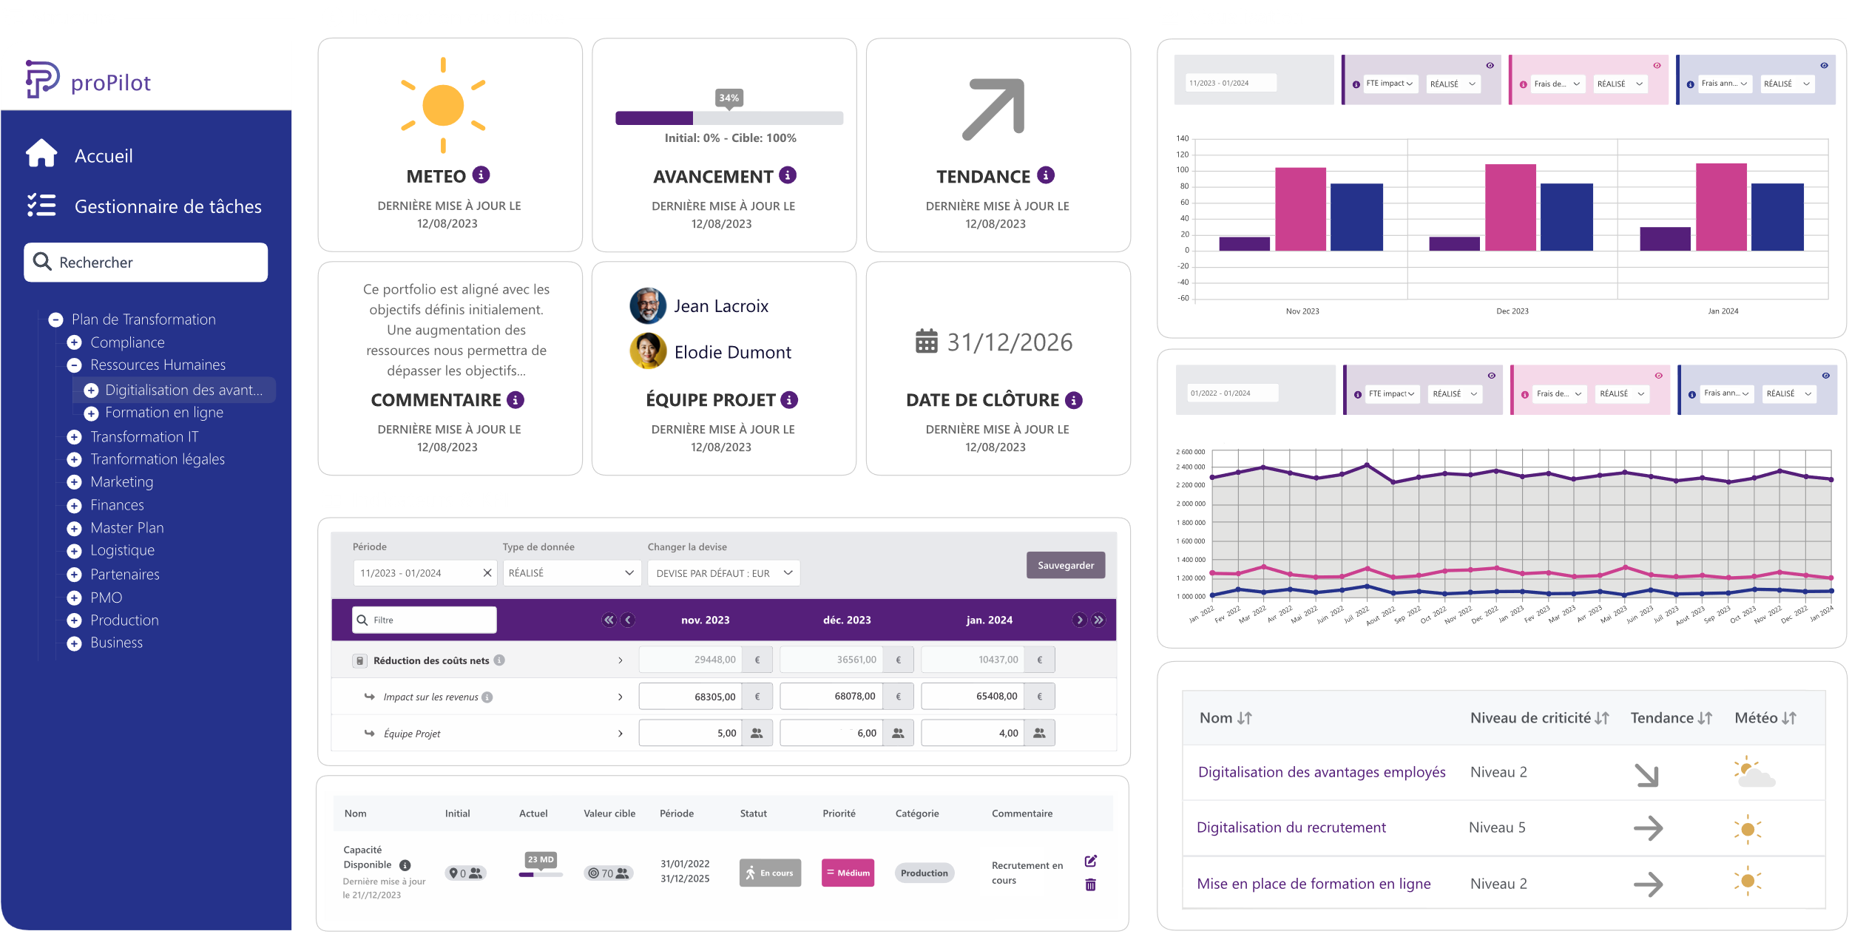





Simple to use for everyone
Fast onboarding (5 minutes)
Be informed about what matters
Update achievements (less than 30 seconds per month)
Share qualitative and quantitative key information
Validate changes and adapt your plan on the fly

Slide 25




“The proPilot solution from dFakto allowed us to maintain control of our plan at every moment.
We monitor progress and take action on identified risks.
The plan is updated and shared with all stakeholders, eliminating manual tasks. This continuous tracking enabled us to exceed our initial goals.”
“We chose proPilot, a well-known solution within the Government that has proven its effectiveness. We were able to provide the plan to ministries and Deputy Prefects for Recovery within a few weeks.
Month after month, we tracked the progress of the plan and our commitments nationwide, while engaging the community responsible for the recovery.”
Hervé Gouëzel
Head of « mission de Rapprochement BNP Paribas & Fortis » (2009-2012) and Head of « Simple and Efficient » (2013-2015).
Bruno Parent
Secretary General in charge of the Recovery Plan - SGPR

Slide 26

France 2030
Secrétariat Général pour l’Investissement (SGPI)
Problématique:
Le SGPI assure l'évaluation financière et socio-économique des grands projets d'investissement public. Il assure sous l’autorité du Premier Ministre, la cohérence et le suivi de la politique d’Investissement de l’Etat qui mobilise 54 milliards d’euros pour faire de la France un leader du monde de demain. Il est nécessaire de disposer d’une plateforme pour digitaliser le suivi des politiques publiques afin d’être auditable et d’automatiser la création des différents tableaux de bord.
Solution:
Mise en place de proPilot pour intégrer 10 ans de données historiques des PIA1 à 4. Intégrer le nouveau plan France 2030 et assurer une plateforme unique pour toutes les parties prenantes des opérateurs de l’Etat à l’Assemblée Nationale en passant par les Ministères et les Préfectures.
Etude de cas proPilot: France 2030

Slide 27

proPilot permet d’assurer en continu l’évaluation des investissements publics. Il permet d’apprécier à moyen et long terme l’ensemble des coûts et des avantages des projets. L’évaluation permet d’assurer que les effets observés d’un investissement sont bien conformes à ceux attendus.
Si la trajectoire empruntée s’écarte de celle qui permettra d’atteindre la cible fixée à l’horizon prévu, des mesures correctives peuvent être mises en place sans attendre la fin de l’investissement. Cette évaluation est dite in itinere.
Fabienne Larose
Responsable système d'information financier et de la donnée
Secrétariat Général pour l'Investissement,
Première Ministre.

Slide 28

proPilot supports organizations to accelerate their value creation
40 000+
Users in private and public sector
110 000+
Projects currently piloted by proPilot
100+
Strategic, tactic and or operational plans
40+
Countries
proPilot Univers

Slide 29
Product Presentation
dFakto: What we are looking for

Slide 30








dFakto’s generic ‘tooled’ governance framework
ISO 38500 GOVERNANCE
Consulting
& Delivery
Evaluate
Maintenance & Evolutions (optional)
& partners
Drive
Measure
& partners
Simplifying Complexity
(governance meetings)
built to run • designed to change
actions
feedback
data
PEOPLE
PROJECTS
SYSTEMS
& DATABASES
OPERATIONS

Slide 31
dFakto is looking for
Consulting
& Delivery
Maintenance & Evolutions (optional)
& partners
& partners
Partnerships
beVault VAR/OEM
  Technical partners looking for data automation solutions
  Data experts & Technical partners looking for data-vault certified solutions
proPilot VAR/OEM:
  Business partners looking for simple-to-configure and easy-to-use piloting solutions
Joint Venture
  business consulting firms interested in ‘tooled consulting’ business models
Funding
Investment Round planned in 2025 Q1
  Please contact me for further details

Slide 32
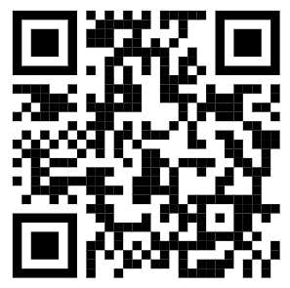

Linkedin: https://www.linkedin.com/in/tdevylder/
Thibaut De Vylder
CEO
+32 478 69 21 86
tdv@dfakto.com

